Slide 1
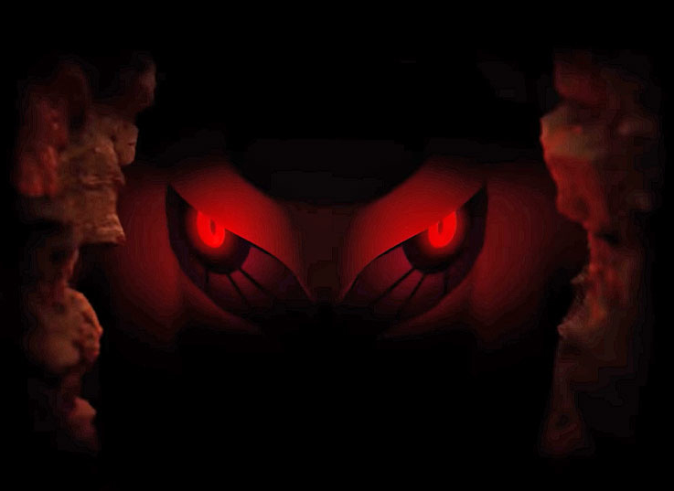
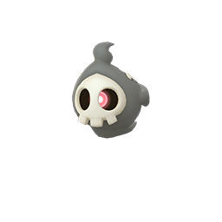
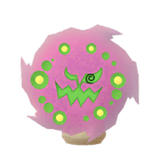

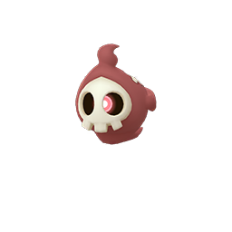



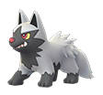

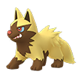
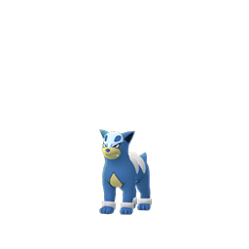

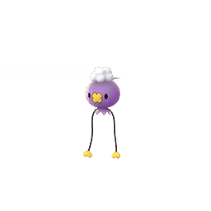
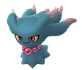


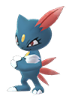


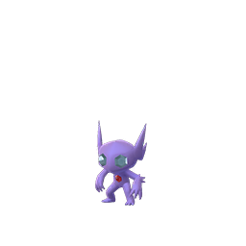
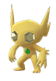
Pokemon GO
Halloween October Field Research Tasks
Transfer A Pokemon
Encounter (Misdreavus )
Catch ( 5 )
Poochyena Or Houndour
Encounter ( Sneasel )
Evolve ( 3 ) Duskull or Shuppet
Rare Candy x1
Catch ( 5 ) Dark Type Pokemon
Stardust ( x500 )
Catch ( 10 ) Ghost Type Pokemon
Encounter
(Sableye could be a Shiny )

